Slide 1
Uncommon Tricks for Enhanced Security Vincent LE TOUX (VINCI, France)
Unveiling Active Directory Secrets

Slide 2


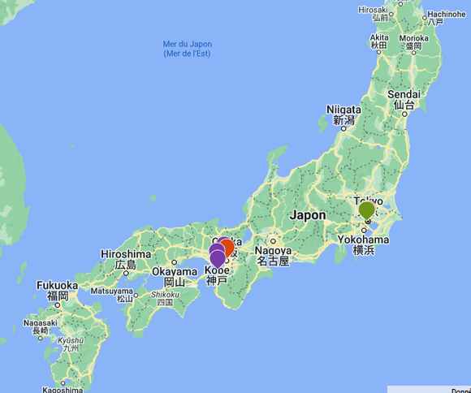

About
GLOBAL PLAYER IN CONCESSIONS, ENERGY AND CONSTRUCTION
French group
250 000 employees
Participation of 40% from VINCI Airports
End of contract (year):
2060
2

Slide 3
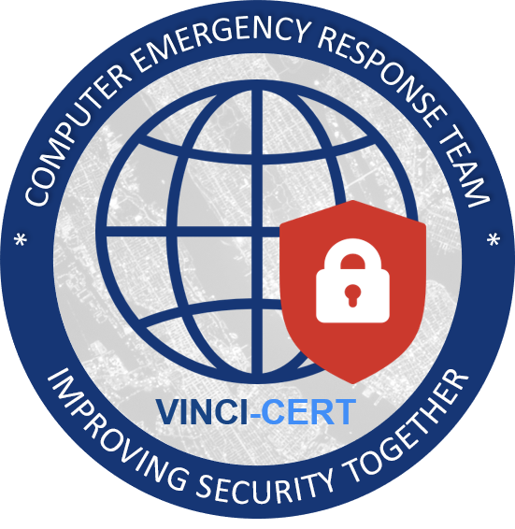







About us
4th presentation by the VINCI-CERT at the annual conference
Vincent has already spoken at many conferences (FIRST, BlackHat US&EU, BlueHatIL, RomHack, HackinParis, …) mostly on Active Directory topics (PingCastle & Mimikatz)
@mysmartlogon
Vincent LE TOUX
Head of VINCI-CERT
Tanguy LE BRETTON
VINCI-CERT analyst
Marc VILLAIN
Security Project Manager
https://www.vinci.com/cert
Ewen FERTIL
VINCI-CERT analyst
3

Slide 4




Introduction
Level of difficulties / understanding / impact
12 tips to be presented
#X: Title
Easy
What is this ?
3 steps explanation
Why it is a problem ?
How to fix detect it / mitigate it ?
!
I’m using a Windows 2008 for the presentation because I own a license. But all the items presented works on newer OS

Slide 5
In Summary
Unusual Config | #1: user vs inetOrgPerson classes | Easy
 | #2: Backup files of GPO are not replicated | Easy
 | #3 forgotten Ownership of AD Objects | Easy
Stay Silent | #4 Anonymous Bind Usage | Easy
 | #5 NT4 API Abuse | Advanced | Demo !
 | #6 Dynamic Objects for Stealth | Medium
 | #7 AV Detection via SID Resolution | Advanced | Demo !
 | #8 Abuse network auth to get password | Advanced | Demo !
Admin tricks | #9 Smart card logon for dummies | Medium | Demo !
 | #10 AD Denial of Service | Easy | Demo !
Investigate | #11: Replication Data and Timeline | Easy | Demo !
 | #12: DPAPI Key Vulnerability Reminder | Easy

Slide 6
Unusual configuration

Slide 7
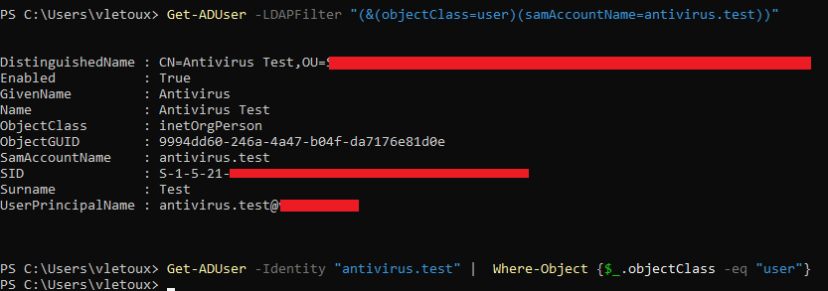
#1: user vs inetOrgPerson classes
Easy
What is this ?
Why it is a problem ?
How to fix it / detect it / mitigate it ?
InetOrgPerson is the class « user » LDAP class. However, Microsoft uses the default « user ».
InetOrgPerson inherits from user, so classes can be switched easily
Set-ADUser SaraDavis -Add @{objectClass='inetOrgPerson'}
Just search and replace the class InetOrgPerson by User
Set-ADUser SaraDavis -Remove @{objectClass='inetOrgPerson'}
Powershell filter isn’t working correctly.
See above of a LDAP filter (which works correctly) vs the Where clause in powershell

Slide 8
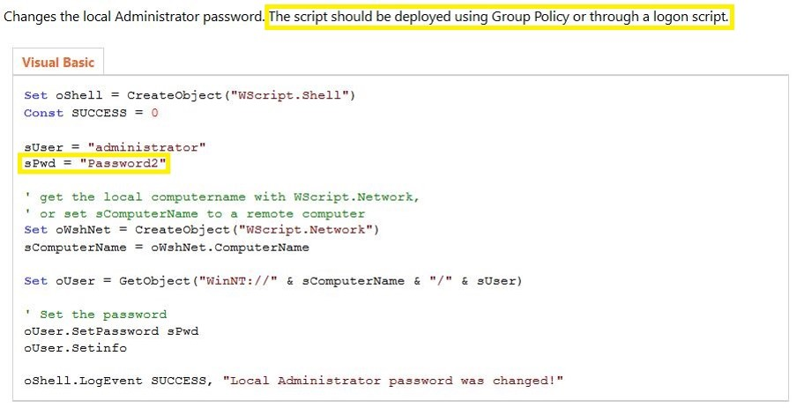
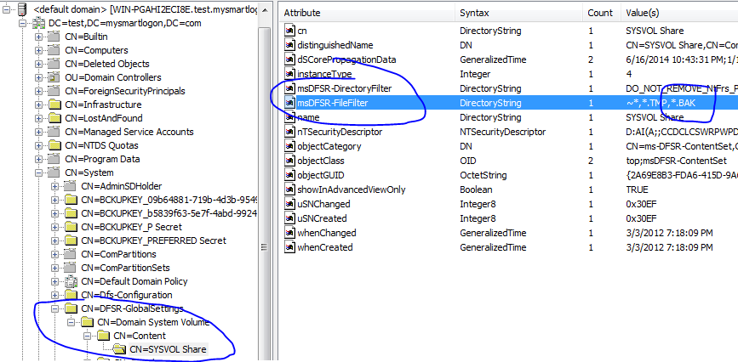
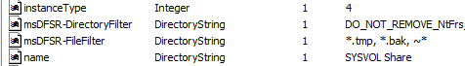
#2: Backup files of GPO are not replicated
Easy
What is this ?
Why it is a problem ?
How to fix it / detect it / mitigate it ?
Iterate the SYSVOL on each DC to find .bak files
The SYSVOL Folder is published through DFRS.
That means backup files of :
Login script
Group policy containing obfuscated passwords (groups.xml, services.xml, scheduledtasks.xml, datasources.xml,printers.xml,drives.xml )
are not checked by AD audit tools looking at a single DC.
As a reminder DFRS do not replicate .bak and .tmp files.

Slide 9
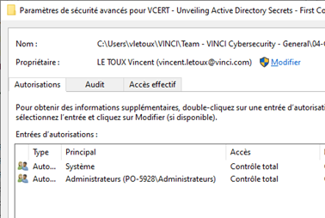
#3 forgotten Ownership of AD Objects
Easy
What is this ?
Why it is a problem ?
How to fix it / detect it / mitigate it ?
Owner can overwrite permissions, even without any write access.
1) Reset the domain controller account password and you become the DC
2) Secrets are stored in some attributes.
You can become local admin by reading the LAPS password.
Audit the AD object owners
User Get-ADUser with the property ntSecurityDescriptor.Owner
See link https://blog.piservices.fr/post/2021/03/29/powershell-who-s-owner-of-my-ad-object
Users / Computers may create AD objects.
(ex: when 'ms-DS-MachineAccountQuota’ is not zero)
They become the owner of the object, and can overwrite the permissions. (in some case, mS-DS-CreatorSID is set)
Other: when a server is promoted as DC: who added it in the AD ?
$adObject = Get-ADUser -Identity 'username'
$acl = Get-Acl -Path "AD:\$($adObject.DistinguishedName)"
$rule = New-Object System.Security.AccessControl.ActiveDirectoryAccessRule `
-ArgumentList @(
'username', # Identity
'GenericAll', # Active Directory rights
'Allow', # Type of access rule
[guid]::empty, # Inheritance type
'None', # Inheritance flags
[guid]::empty # Object type
)
$acl.AddAccessRule($rule)
Set-Acl -Path "AD:\$($adObject.DistinguishedName)" -AclObject $acl

Slide 10
Stay silent

Slide 11
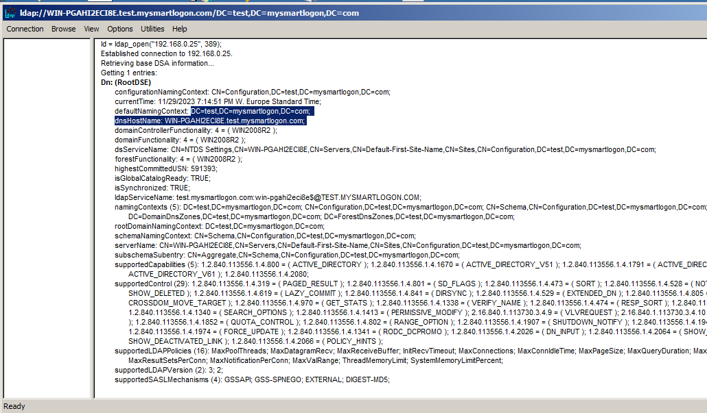
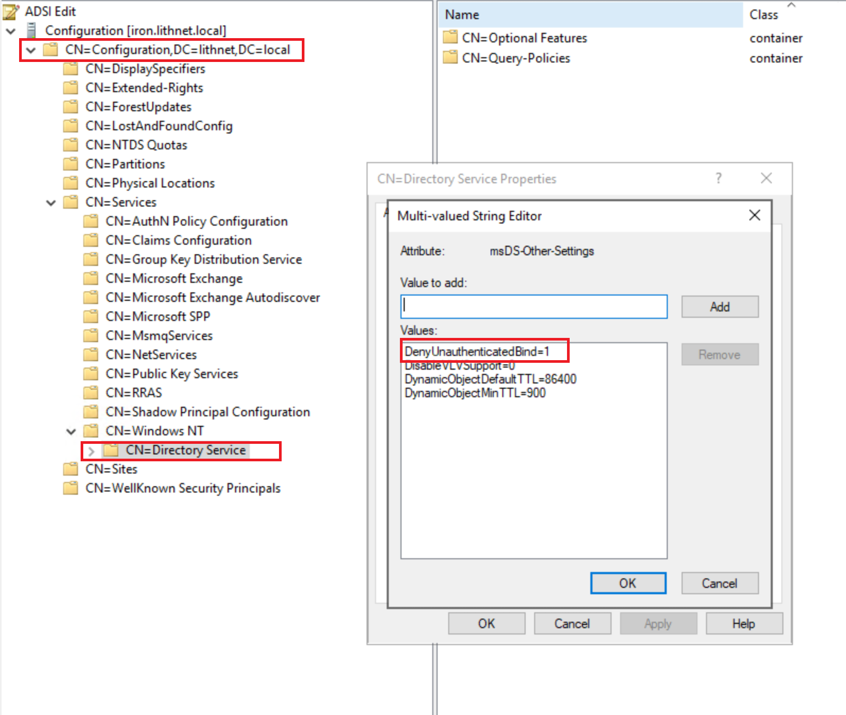
#4 Anonymous Bind Usage
Easy
What is this ?
Why it is a problem ?
How to fix it / detect it / mitigate it ?
« Anonymous bind » can be used on every DC.
Basic information about the server FQDN, OS type, …
Sadly, not a vulnerability
Can be disabled only starting Windows Server 2019 (DenyUnauthenticatedBind)

Slide 12

#5 NT4 API Abuse
Advanced
What is this ?
Why it is a problem ?
You can set your password without the password in clear text.
No password complexity checks.
CLEAR TEXT PASSXORD
Hash update if password changed
DENIED ! PASSWORD NOT COMPLEX ENOUGH
Classic way to change the password
0 1 0 1 1
1 1 0 0 1
How to fix it / detect it / mitigate it ?
CLEAR TEXT PASSXORD
NTLM HASH
RPC firewall can block SamrChangePasswordUser.
The other call SamrSetInformationUser is used for genuine purpose
No solution for the moment.
DONE !
NT4 way to change the password

Slide 13
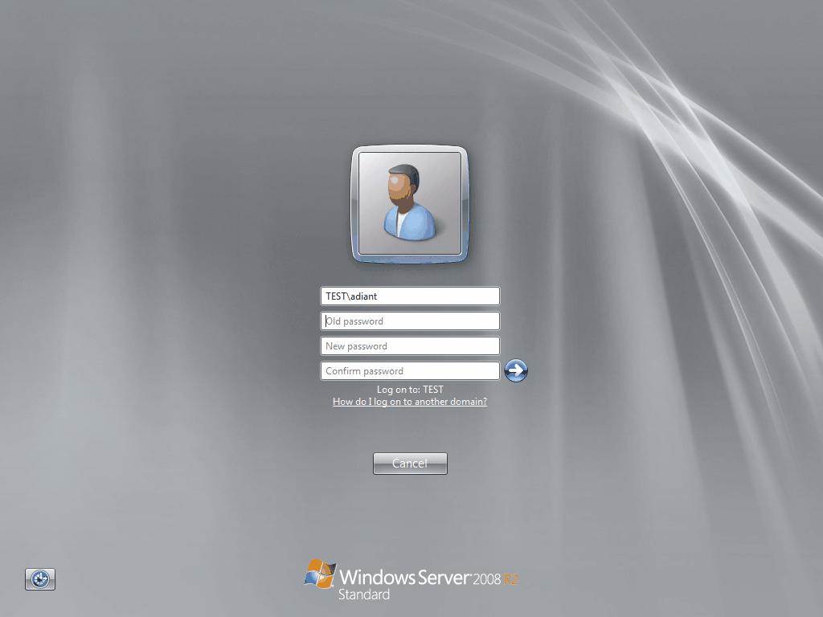
#5 Demo !
https://github.com/vletoux/NTLMInjector
Limits:
Change password to zero char ✗
Usable for kerberos AES256 ✗ (immediate password change proposed at login time)

Slide 14
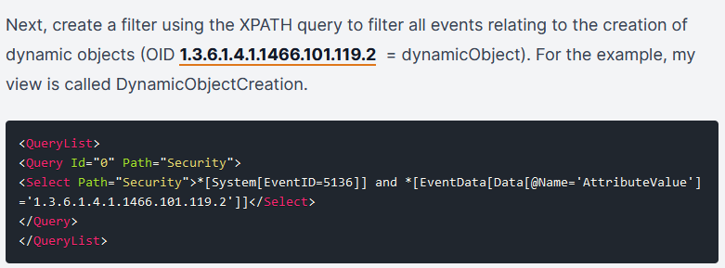
#6 Dynamic Objects for Stealth
Medium
What is this ?
Why it is a problem ?
How to fix it / detect it / mitigate it ?
A special class that add ends of life to objects at a specific date.
Minimum lifetime: 1h
Needs to be specified at creation time. Cannot be granted later
Leave no traces, even in recycle bin. No replication logs at deletion.
Track object creation and add a filter on objectclass
[int]$intDynTTL = “15”
$intDynTTL = $intDynTTL * 60
$objDomain = New-Object System.DirectoryServices.DirectoryEntry(“LDAP://OU=Accounts,DC=contoso,DC=com”)
$objName = “DYNUSER1”
$objDyn = $objDomain.Create(“user”, “CN=” + $objName)
$objDyn.Put(“objectClass”, @(“dynamicObject”,“user”) )
$objDyn.Put(“entryTTL”, $intDynTTL )
$objDyn.Put(“sAMAccountName”, $objName )
$objDyn.SetInfo()
Normal account
Recycle bin
Marked as deleted
Dynamic account
https://itpro-tips.com/detect-the-creation-of-ad-dynamic-objects/
No data for forensic analysis

Slide 15
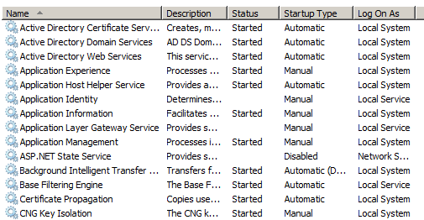
#7 AV Detection via SID Resolution
Advanced
What is this ?
Why it is a problem ?
SERVICE NAME
USER NOT FOUND
HERE IS THE SID
You can use SID resolution (no permissions) to check if a service (aka antivirus) is installed
To be differentiated from SYSTEM, each service has a local service name:
NT SERVICE\<Service name>
Thus, it needs an SID to set permissions. SID = S-1-5-80-XXXX-XXXXX-XXXX (aka hash(<Service Name>))
How to fix it / detect it / mitigate it ?
No solution for the moment.

Slide 16
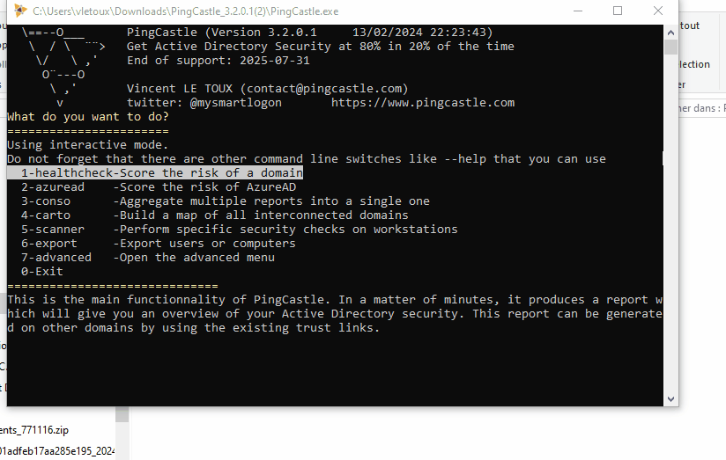
Demo
https://github.com/vletoux/TestAntivirus
Or
https://www.pingcastle.com/download

Slide 17
#8 Abuse network auth to get password
Advanced
What is this ?
Why it is a problem ?
You can authenticate yourself with a service you host.
You can see the packet Exchanged.
If you want to test a password, you can check if the crypto matches.
!!! There is a local “optimization” to disable password hashing. It has to be disabled !!!
CLEAR TEXT PASSWORD
DONE !
Interactive Login
NTLM HASH
How to fix it / detect it / mitigate it ?
A lot of data exchange !
Search for event 4624 with Logon Type: 3
(https://learn.microsoft.com/en-us/previous-versions/windows/it-pro/windows-10/security/threat-protection/auditing/event-4624)
DONE !
Network login

Slide 18
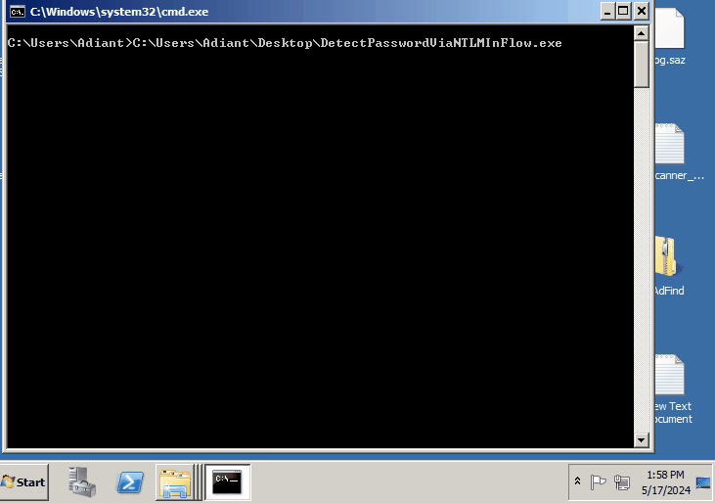
Demo !
https://github.com/vletoux/DetectPasswordViaNTLMInFlow

Slide 19
Admin trick

Slide 20
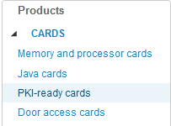

#9 Smart card logon for dummies
Medium
What is this ?
How to use it ?
Step1: Get a Card
A) Buy PKI smart card on smart card focus
B) Or enable PKI feature (aka: PIV applet with Yubikey)
C) Or build yourself:
Get a javacard with RSA support (1$ !)
Install a PKI applet on it (GIDSApplet, IsoApplet, …)
Step2: Use it
Linux : Use OpenSC
Windows: If applet is GIDS or PIV, nothing to do. Else, install a “CSP” or “minidriver”
Run “certutil –scinfo” to check the installation
Then ADCS => request Certificate => Use CSP
Same chip than:
SIM card (phone)
EMV (credit card)
= CHEAP
Demo !
Why it is NOT a problem ?
No password anymore.

Slide 21
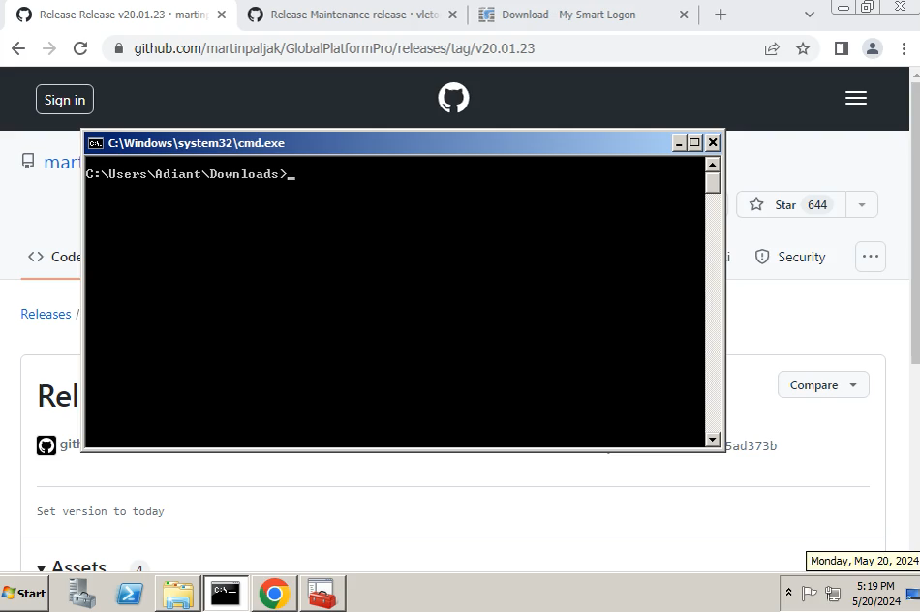
Demo length: 2:30
#1: insert an empty card
0:00 -> 0:11
#2: install GIDS applet
0:11 -> 1:00
#3: personalize applet (set PIN)
1:00 -> 1:24
#4: Request CERT
1:24 -> 2:15
#5: Login demo
2:15 -> 2:30

Slide 22
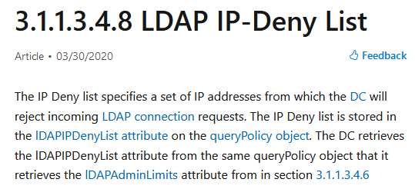
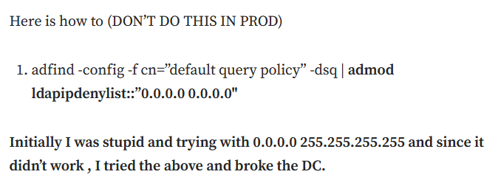

#10 AD Denial of Service
Easy
What is this ?
Why it is a problem ?
How to fix it / detect it / mitigate it ?
Except using IPV6
I don’t know !
https://medium.com/@nannnu/the-f-c-urious-case-of-the-ldapipdenylist-8e5799cd9ce
DC
LdapIpDenyList
Attribute
Is the incoming IP in the LDAP IP-Deny List ?

Slide 23
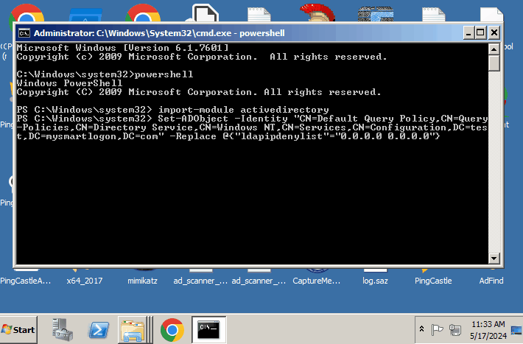
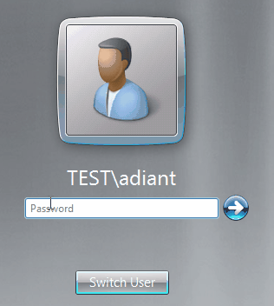
#10 AD Denial of Service - Demo

Slide 24
Investigate

Slide 25

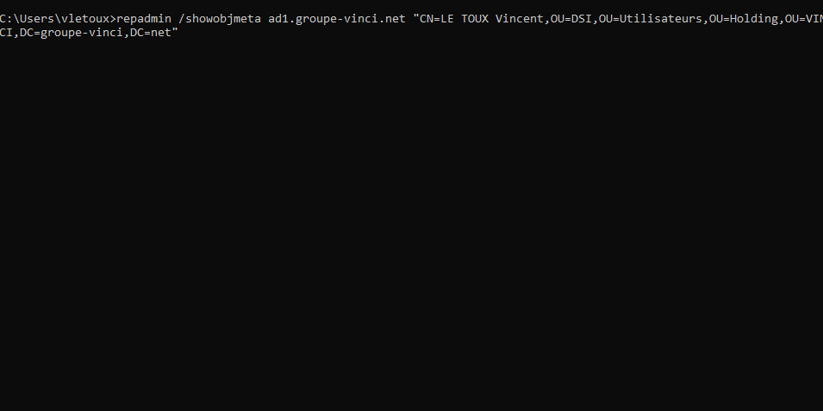
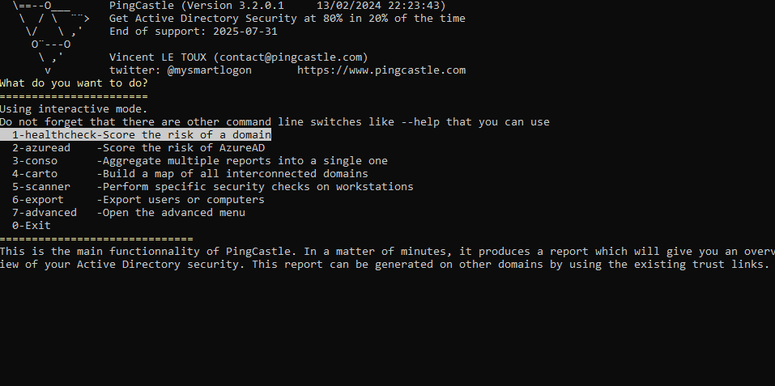
#11: Replication Data and LDAP notifications
Easy
What is this ?
Why it is NOT a problem ?
How to use it ?
A) Information in public access to debug replication issue
B) Flag in LDAP to see changes in realtime (with 15 minutes delay if replicated)
A) Used to know in IR when data has been changed:
Created users
Modified group
Password reset
B) Put in place a monitoring during IR in 2 minutes
https://github.com/ANSSI-FR/ADTimeline
repadmin /showobjmeta * "C N=…”
https://pingcastle.com/download
A
B

Slide 26
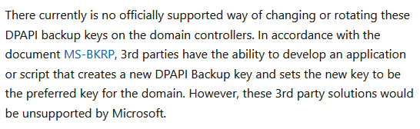


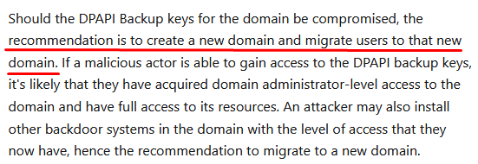
#12: DPAPI Key Vulnerability Reminder
Easy
What is this ?
Why it is a problem ?
How to fix it / detect it / mitigate it ?
Compromise checklist
Reset:
- the krbtgt ✓
- Service accounts ✓
- the admin passwords ✓
- the user passwords ✓
AD DPAPI master key ✗
Hunting:
Investigate Event 4662 with object bckupkey
User password
AD Master key
DPAPI
Passwords
Password database
DPAPI is used to encrypt sensitive stuff, such as secret.
Used everyday to prevent the admin from eye dropping your saved passwords.
https://learn.microsoft.com/en-us/windows/win32/seccng/cng-dpapi-backup-keys-on-ad-domain-controllers

Slide 27
Conclusion

Slide 28
In Summary
Question ?
EMAIL:
vincent.letoux @vinci.com
Recommended tool for AD audit:
PingCastle
Twitter / X:
@mysmartlogon
Unusual Config | #1: user vs inetOrgPerson classes | Easy
 | #2: Backup files of GPO are not replicated | Easy
 | #3 forgotten Ownership of AD Objects | Easy
Stay Silent | #4 Anonymous Bind Usage | Easy
 | #5 NT4 API Abuse | Advanced
 | #6 Dynamic Objects for Stealth | Medium
 | #7 AV Detection via SID Resolution | Advanced
 | #8 Abuse network auth to get password | Advanced
Admin tricks | #9 Smart card logon for dummies | Medium
 | #10 AD Denial of Service | Easy
Investigate | #11: Replication Data and Timeline | Easy
 | #12: DPAPI Key Vulnerability Reminder | Easy

